Slide 1
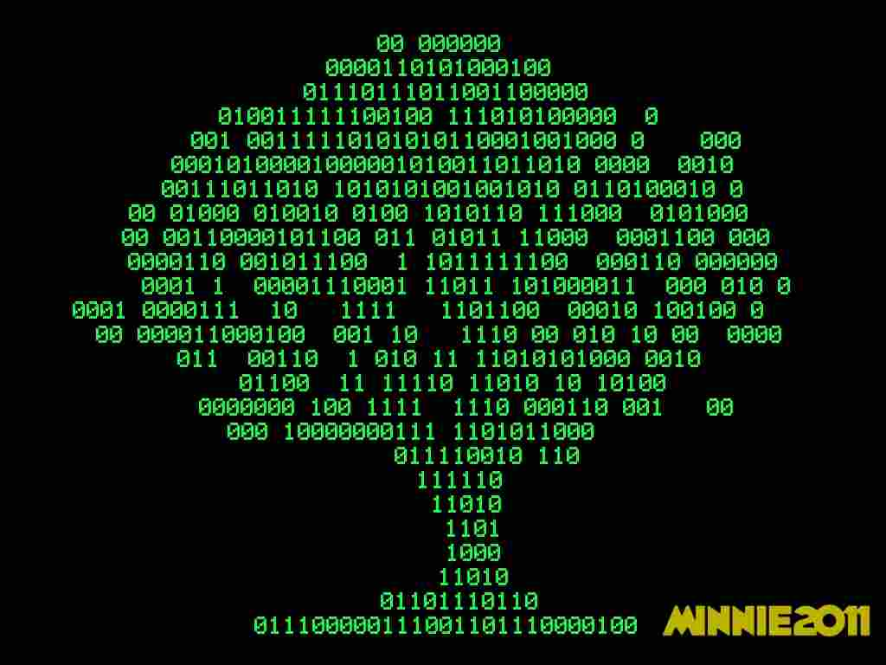
Data Structures
Adithya B
Asst. Prof.,
Dept. Of CSE, JIT

Slide 2


Slide 3
CONVEX HULL PROBLEM

Slide 4
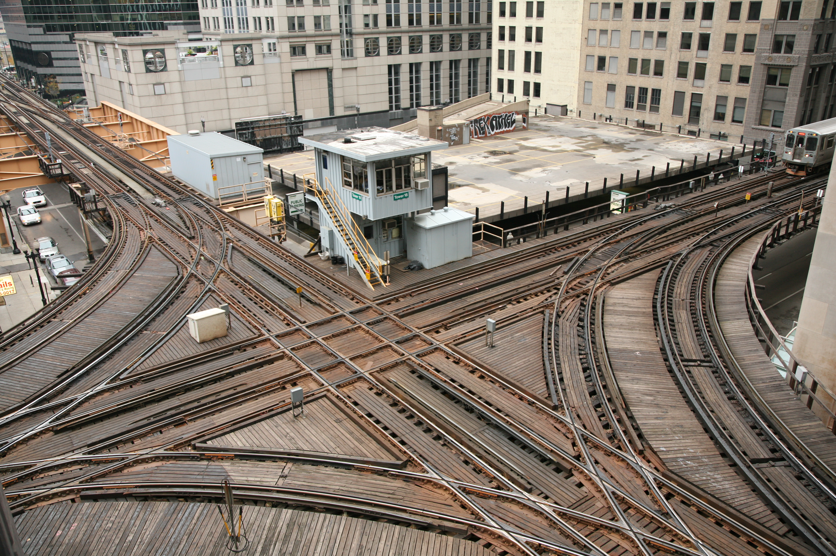
Graph Theoritical Problem

Slide 5
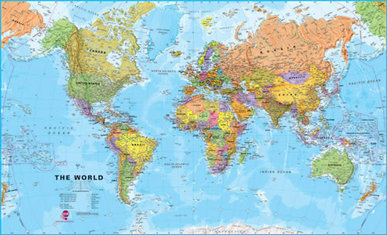
Scaling and plotting problem

Slide 6
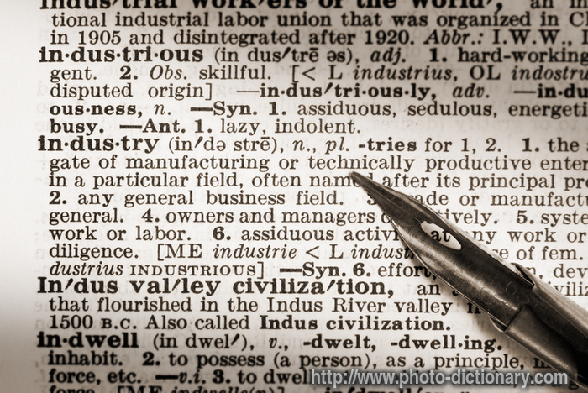
Digitization and Dictonary Probelm

Slide 7
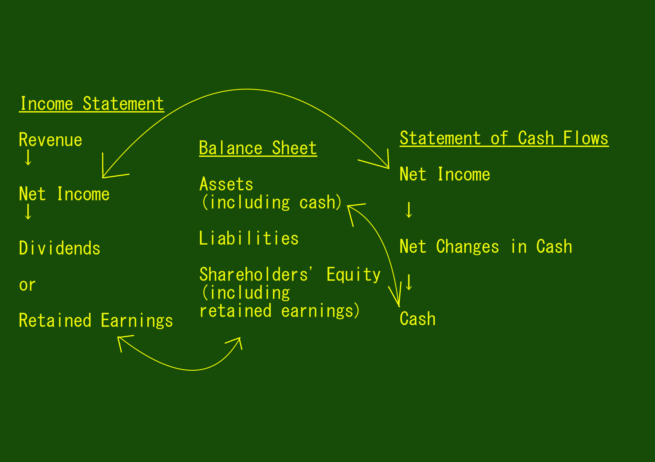
Data Flow Problem

Slide 8
What is it?
A particular way of organizing data in a computer so that it can be used efficiently [Ref: Wikipedia]
Any of various methods or formats (as an array, file, or record) for organizing data in a computer [Ref: merriam webster]
The arrangement of and relations between the parts or elements of something complex [Ref: Oxford Dictonary]

Slide 9

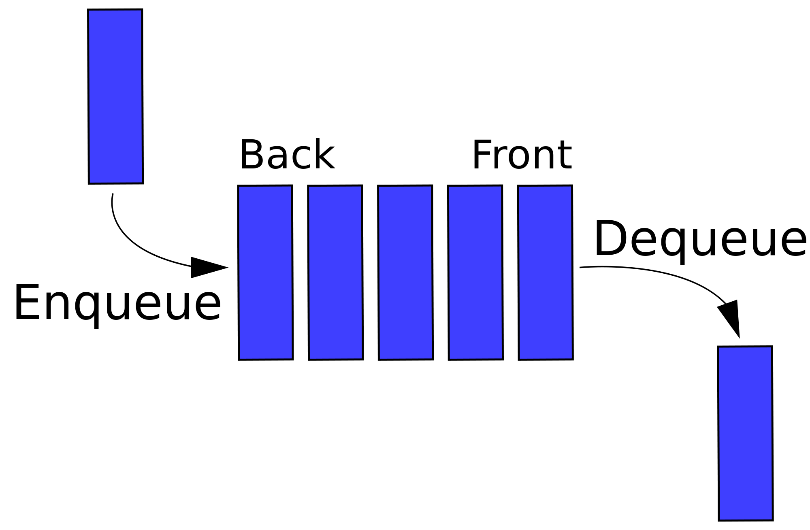
Data Structure and abstraction
Mathematical and Logical Models
Abstract View of data struture
`

Slide 10
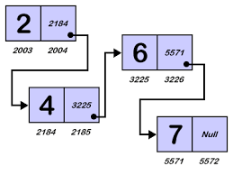
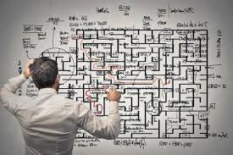
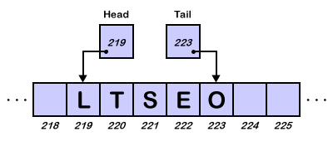
Implementation

Slide 11
Convex Hull Problem
5 2 4 7
2 4 5 7
101 010 100 111
010 100 101 111
100
111
010
101
0
1

Slide 12
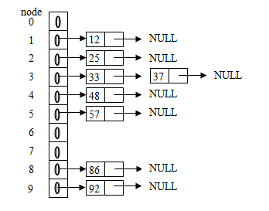
Address Resolution Sorting
25 57 48 37 12 92 86 33
25 – f(25) gives 2
57 – f(57) gives 5
48 – f(48) gives 4
37 – f(37) gives 3
12 – f(12) gives 1
92 – f(92) gives 9
86 – f(86) gives 8
33 – f(33) gives 3

